Slide 1
BCTS Northern GIS Services Pilot
Collaboration , Continuity and Capability

Slide 2
What is the pilot about?
4 participating B.A.s (TCC, TPG, TPL and TSN)
9 GIS staff with 1 GIS Coordinator - HQ
Pooled resources
Common workload repository
Shared common workload when necessary
Shared understanding of priorities
Lever ability to work remotely
Build towards best practices
Common GIS data management

Slide 3
Why collaborate?
Operations depend on GIS
Many GIS services are conducive to remote work
Workloads fluctuate
GIS skills can be broad and specialized
GIS staff are very marketable
Hiring/training GIS staff can be challenging
Varied GIS practices between Business Areas
Coordinating GIS activities challenging

Slide 4
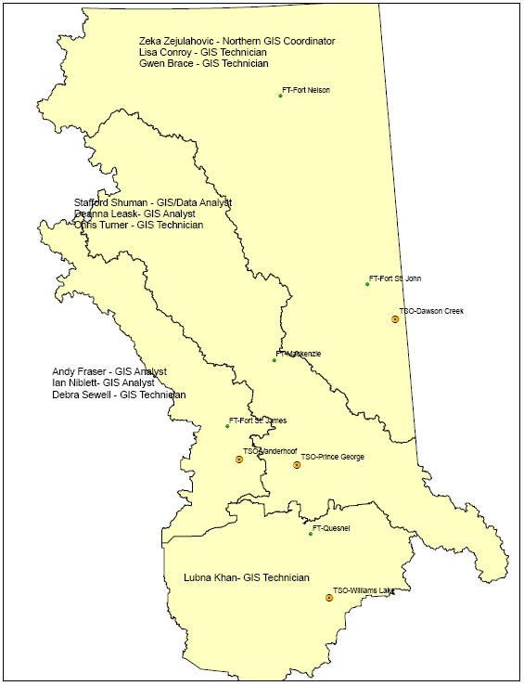
Structure
Steering Committee
Sr Manager Business Information
Prov GIS Coordinator
Pilot’s GIS Coordinator
TCC
Lubna Kahn
Vacant
TPG
Deanna Leask
Stafford Shuman
Chris Turner
TPL
Vacant
Lisa Conroy (TCC -80%)
Gwen Brace
TSN
Andy Fraser
Ian Niblett
Deb Sewell

Slide 5
Pilot Deliverables
Service Request process
Workload Prioritization
Process for sharing workloads
Procedures for ID’ing and implementing BP’s
Identification of GIS skill sets
Staff developmental opportunities
Gap Analyses – Equalizing Business Area data stewardship levels

Slide 6
Progress
  Staff coverage
    GIS Analyst hired within 1 month of start – TCC
    GIS Analyst vacancy - TPL
    GIS Technician vacancy – TCC
    GIS Technician – Educational leave – TPG
    GIS Analyst– Bereavement leave – TPG
    GIS Data Analyst – Part time hours - TPG (20%)
    GIS Technician – Part time hours – TPL (20%)
  Workload
    Monthly workload metric capturing and monitoring
    TPL GIS technician dedicated 80% to TCC
    TSN staff providing bulk of shared workload coverage
    TCC primarily benefitting from shared resources
    Identification of GIS-related tasks beyond workload prioritization list/repository
    Common workload repository viewable by all BA staff
    Collaborative effort to best practices/ working groups and Pilot intiatives

Slide 7
Progress – cont’d
  Best Practices
    Peaches server data share
    Brushing processes compared/contrasted amongst BA’s
    Planting processes compared/contrasted amongst BA’s
    Survey processes comparison in progress
    Elements of Multi-phase compared/contrasted

Slide 8
Progress – cont’d
Services
  Regular services as before continued
  Provided monthly reports on Corp Mandatories
  Training of non-GIS staff on GIS capabilities
  Monthly reports on workload metrics
  Scheduled Field team visits
  Scheduled site visits
  Scheduled integration with Business Area leadership meetings

Slide 9
Feedback
Steering Committee
  Very positive – desire to continue
GIS Staff
  Surveys conducted – May & November
    Generally positive
    Some concern regarding staffing levels, training & motives
Business Area staff
  Survey in May/2012 and Jan/2013
    Vast majority positive to very positive
    Desire to learn more about GIS
    Communication remains consistent or has improved

Slide 10
Questions?

